Slide 1

Copyright © 2003 Pearson Education, Inc.
Slide <number>
Notes:
These are not my slides. You could Google it.
Some slides are removed. 3 slides from other source were added

Slide 2
Chapter 15
Pointers
and
Linked Lists
Created by David Mann, North Idaho College
Copyright © 2003 Pearson Education, Inc.
Slide <number>

Slide 3
Overview
Nodes and Linked Lists(15.1)
A Linked List Application (15.2)_x000b_
Copyright © 2003 Pearson Education, Inc.
Slide <number>

Slide 4
Nodes and Linked Lists
15.1
  A linked list is a list that can grow and shrink while
  the program is running
  A linked list is constructed using pointers
  A linked list often consists of structs or classes that
  contain a pointer variable connecting them to other
  dynamic variables
  A linked list can be visualized as items, drawn as
  boxes, connected to other items by arrows
head
10
12
14 | end
Copyright © 2003 Pearson Education, Inc.
Slide <number>

Slide 5
Nodes
The boxes in the previous drawing represent the
nodes of a linked list
  Nodes contain the data item(s) and a pointer that can
  point to another node of the same type
    The pointers point to the entire node, not an individual
    item that might be in the node
The arrows in the drawing represent pointers
Display 15.1
Copyright © 2003 Pearson Education, Inc.
Slide <number>

Slide 6
Implementing Nodes
Nodes are implemented in C++ as structs or
classes
  Example: A structure to store two data items and
  a pointer to another node of the same type,
  along with a type definition might be:
  struct ListNode
  {
  string item;
  int count;
  ListNode *link;
  };
  typedef ListNode* ListNodePtr;
This circular definition
is allowed in C++
Copyright © 2003 Pearson Education, Inc.
Slide <number>

Slide 7
The head of a List
The box labeled head, in display 15.1, is not a
node, but a pointer variable that points to a node
Pointer variable head is declared as:
ListNodePtr head;
Copyright © 2003 Pearson Education, Inc.
Slide <number>

Slide 8
Accessing Items in a Node
Using the diagram of 15.1, this is one way to
change the number in the first node from
10 to 12:
(*head).count = 12;
  head is a pointer variable so *head is the node that
  head points to
  The parentheses are necessary because the dot
  operator . has higher precedence than the
  dereference operator *
Copyright © 2003 Pearson Education, Inc.
Slide <number>

Slide 9
The Arrow Operator
The arrow operator -> combines the actions of
the dereferencing operator * and the dot operator
to specify a member of a struct or object pointed
to by a pointer
  (*head).count = 12;
  can be written as
  head->count = 12;
  The arrow operator is more commonly used
Display 15.2
Copyright © 2003 Pearson Education, Inc.
Slide <number>

Slide 10
Linked Lists
The diagram in Display 15.2 depicts a linked list
A linked list is a list of nodes in which each node
has a member variable that is a pointer that
points to the next node in the list
  The first node is called the head
  The pointer variable head, points to the first node
    The pointer named head is not the head of the list…it
    points to the head of the list
  The last node contains a pointer set to NULL
Copyright © 2003 Pearson Education, Inc.
Slide <number>

Slide 11
Building a Linked List:
The node definition
Let's begin with a simple node definition:
struct Node
{
int data;
Node *link;
};
typedef Node* NodePtr;
Copyright © 2003 Pearson Education, Inc.
Slide <number>

Slide 12
Building a Linked List:
Declaring Pointer Variable head
With the node defined and a type definition to
make or code easier to understand, we can
declare the pointer variable head:
NodePtr head;
  head is a pointer variable that will point to the
  head node when the node is created
Copyright © 2003 Pearson Education, Inc.
Slide <number>

Slide 13
Building a Linked List:
Creating the First Node
To create the first node, the operator new is used
to create a new dynamic variable:
head = new Node;
  Now head points to the first, and only, node in the
  list
Copyright © 2003 Pearson Education, Inc.
Slide <number>

Slide 14
Building a Linked List:
Initializing the Node
Now that head points to a node, we need to
give values to the member variables of the node:
head->data = 3;
head->link = NULL;
  Since this node is the last node, the link is set to
  NULL
Copyright © 2003 Pearson Education, Inc.
Slide <number>

Slide 15
Function head_insert
It would be better to create a function to insert
nodes at the head of a list, such as:
  void head_insert(NodePtr& head, int the_number);
    The first parameter is a NodePtr parameter that points to the
    first node in the linked list
    The second parameter is the number to store in the list
  head_insert will create a new node for the number
    The number will be copied to the new node
    The new node will be inserted in the list as the new head node
Copyright © 2003 Pearson Education, Inc.
Slide <number>

Slide 16
Pseudocode for head_insert
Create a new dynamic variable pointed to by
temp_ptr
Place the data in the new node called *temp_ptr
Make temp_ptr's link variable point to the head
node
Make the head pointer point to temp_ptr
Display 15.3
Copyright © 2003 Pearson Education, Inc.
Slide <number>

Slide 17
Translating head_insert to C++
The pseudocode for head_insert can be written
in C++ using these lines in place of the lines of
pseudocode:
  NodePtr temp_ptr; //create the temporary pointer
  temp_ptr = new Node; // create the new node
  temp_ptr->data = the_number; //copy the number
  temp_ptr->link = head; //new node points to first node
  head = temp_ptr; // head points to new
  // first node
Display 15.4
Copyright © 2003 Pearson Education, Inc.
Slide <number>

Slide 18
An Empty List
A list with nothing in it is called an empty list
An empty linked list has no head node
The head pointer of an empty list is NULL
head = NULL;
  Any functions written to manipulate a linked list
  should check to see if it works on the empty list
Copyright © 2003 Pearson Education, Inc.
Slide <number>

Slide 19
Losing Nodes
You might be tempted to write head_insert using
the head pointer to construct the new node:
head = new Node;
head->data = the_number;
Now to attach the new node to the list
  The node that head used to point to is now lost!
Display 15.5
Copyright © 2003 Pearson Education, Inc.
Slide <number>

Slide 20
Memory Leaks
Nodes that are lost by assigning their pointers a
new address are not accessible any longer
The program has no way to refer to the nodes
and cannot delete them to return their memory
to the freestore
Programs that lose nodes have a memory leak
  Significant memory leaks can cause system crashes
Copyright © 2003 Pearson Education, Inc.
Slide <number>

Slide 21
Searching a Linked List
To design a function that will locate a particular
node in a linked list:
  We want the function to return a pointer to the node
  so we can use the data if we find it, else return NULL
  The linked list is one argument to the function
  The data we wish to find is the other argument
  This declaration will work:
  NodePtr search(NodePtr head, int target);
Copyright © 2003 Pearson Education, Inc.
Slide <number>

Slide 22
Function search
Refining our function
  We will use a local pointer variable, named here,
  to move through the list checking for the target
    The only way to move around a linked list is to follow
    pointers
  We will start with here pointing to the first node and
  move the pointer from node to node following the
  pointer out of each node
Display 15.6
Copyright © 2003 Pearson Education, Inc.
Slide <number>

Slide 23
Pseudocode for search
Make pointer variable here point to the head node
while(here does not point to a node containing target
AND here does not point to the last node)
{
make here point to the next node
}
If (here points to a node containing the target)
return here;
else
return NULL;
Copyright © 2003 Pearson Education, Inc.
Slide <number>

Slide 24
Moving Through the List
The pseudocode for search requires that pointer
here step through the list
  How does here follow the pointers from node to
  node?
  When here points to a node, here->link is the
  address of the next node
  To make here point to the next node, make the
  assignment:
  here = here->link;
Copyright © 2003 Pearson Education, Inc.
Slide <number>

Slide 25
A Refinement of search
The search function can be refined in this way:
here = head;
while(here->data != target && here->link != NULL)
{
here = here->next;
}
if (here->data = = target)
return here;
else
return NULL;
Check for last node
Copyright © 2003 Pearson Education, Inc.
Slide <number>

Slide 26
Searching an Empty List
Our search algorithm has a problem
  If the list is empty, here equals NULL before the
  while loop so…
    here->data is undefined
    here->link is undefined
  The empty list requires a special case in our
  search function
  A refined search function that handles an empty
  list is shown in
Display 15.7
Copyright © 2003 Pearson Education, Inc.
Slide <number>

Slide 27
Inserting a Node Inside a List
To insert a node after a specified node in the
linked list:
  Use another function to obtain a pointer to the node
  after which the new node will be inserted
    Call the pointer after_me
  Use function insert, declared here to insert the node:
  void insert(NodePtr after_me, int the_number);
Display 15.8
Copyright © 2003 Pearson Education, Inc.
Slide <number>

Slide 28
Inserting the New Node
Function insert creates the new node just as
head_insert did
We do not want our new node at the head of the
list however, so…
  We use the pointer after_me to insert the new node
Copyright © 2003 Pearson Education, Inc.
Slide <number>

Slide 29
Inserting the New Node
This code will accomplish the insertion of the
new node, pointed to by temp_ptr, after the node
pointed to by after_me:
temp_ptr->link = after_me->link;
after_me->link = temp_ptr;
2
3
7
9
head
2
2
2
0
5
after_me
temp_ptr
2
Copyright © 2003 Pearson Education, Inc.
Slide <number>

Slide 30
Caution!
The order of pointer assignments is critical
  If we changed after_me->link to point to
  temp_ptr first, we would loose the rest of the list!
The complete insert function is shown
in
Display 15.9
Copyright © 2003 Pearson Education, Inc.
Slide <number>

Slide 31
Function insert Again
Notice that inserting into a linked list requires
that you only change two pointers
  This is true regardless of the length of the list
  Using an array for the list would involve copying
  as many as all of the array elements to new locations
  to make room for the new item
Inserting into a linked list is often more efficient
than inserting into an array
Copyright © 2003 Pearson Education, Inc.
Slide <number>

Slide 32
Removing a Node
To remove a node from a linked list
  Position a pointer, before, to point at the node prior
  to the node to remove
  Position a pointer, discard, to point at the node
  to remove
  Perform: before->link = discard->link;
    The node is removed from the list, but is still in memory
  Return *discard to the freestore: delete discard;
Display 15.10
Copyright © 2003 Pearson Education, Inc.
Slide <number>

Slide 33
Doubly-linked lists
Here is a doubly-linked list (DLL):
myDLL
a
b
c
Each node contains a value, a link to its successor (if any),
and a link to its predecessor (if any)
The header points to the first node in the list and to the last
node in the list (or contains null links if the list is empty)
Notes:
This slide and next 2 are actually from a different source

Slide 34
DLLs compared to SLLs
Advantages:
  Can be traversed in either direction (may be essential for
  some programs)
  Some operations, such as deletion and inserting before a node,
  become easier
Disadvantages:
  Requires more space
  List manipulations are slower (because more links must
  be changed)
  Greater chance of having bugs (because more links must
  be manipulated)

Slide 35
Deleting a node from a DLL
Node deletion from a DLL involves changing two links
In this example,we will delete node b
myDLL
a
b
c
We don’t have to do anything about the links in node b
Garbage collection will take care of deleted nodes
Deletion of the first node or the last node is a special case

Slide 36
Linked list nowadays!
Google:
Why you should never, ever, EVER use linked-list
Copyright © 2003 Pearson Education, Inc.
Slide <number>

Slide 37
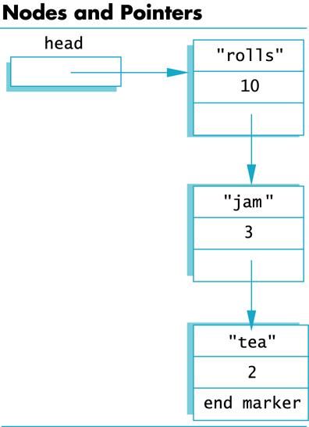
Display 15.1
Back
Next
Copyright © 2003 Pearson Education, Inc.
Slide <number>

Slide 38
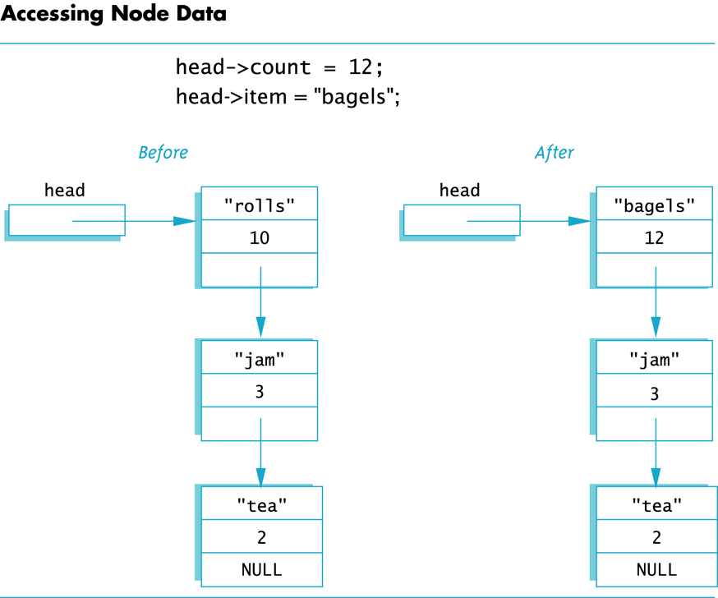
Display 15.2
Back
Next
Copyright © 2003 Pearson Education, Inc.
Slide <number>

Slide 39
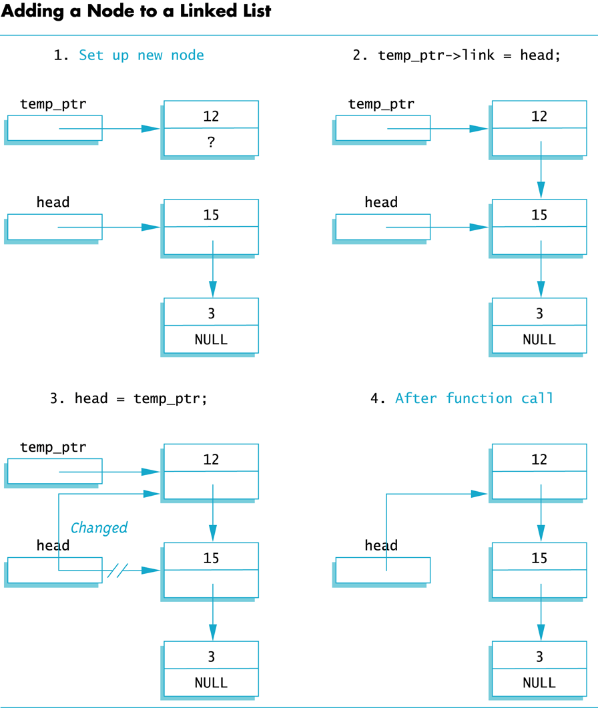
Display 15.3
Back
Next
Copyright © 2003 Pearson Education, Inc.
Slide <number>

Slide 40
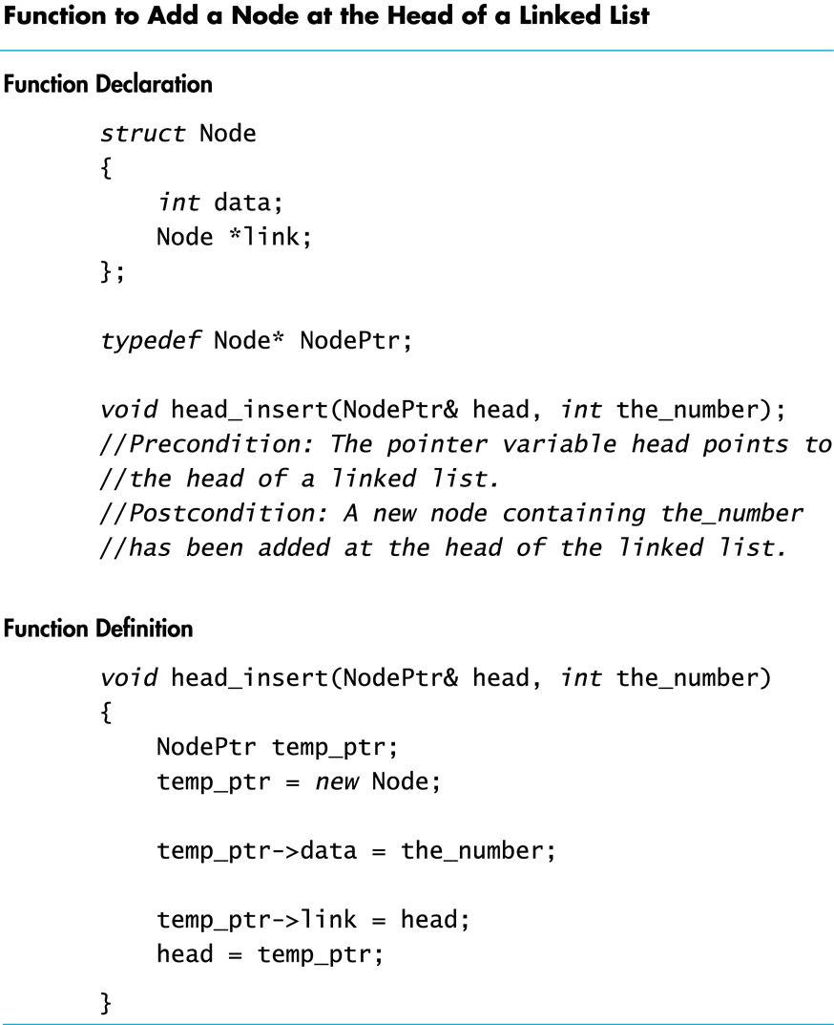
Display 15.4
Back
Next
Copyright © 2003 Pearson Education, Inc.
Slide <number>

Slide 41
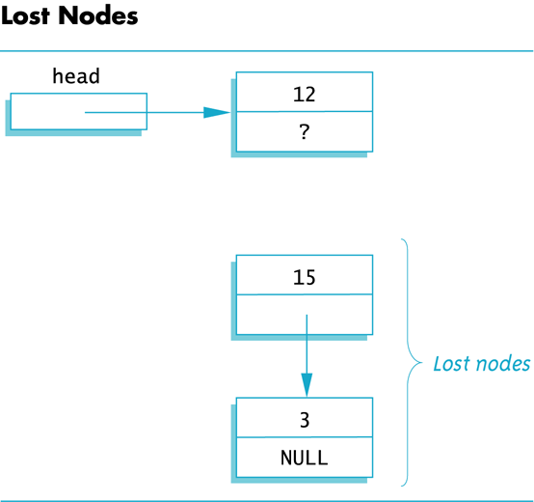
Display 15.5
Back
Next
Copyright © 2003 Pearson Education, Inc.
Slide <number>

Slide 42
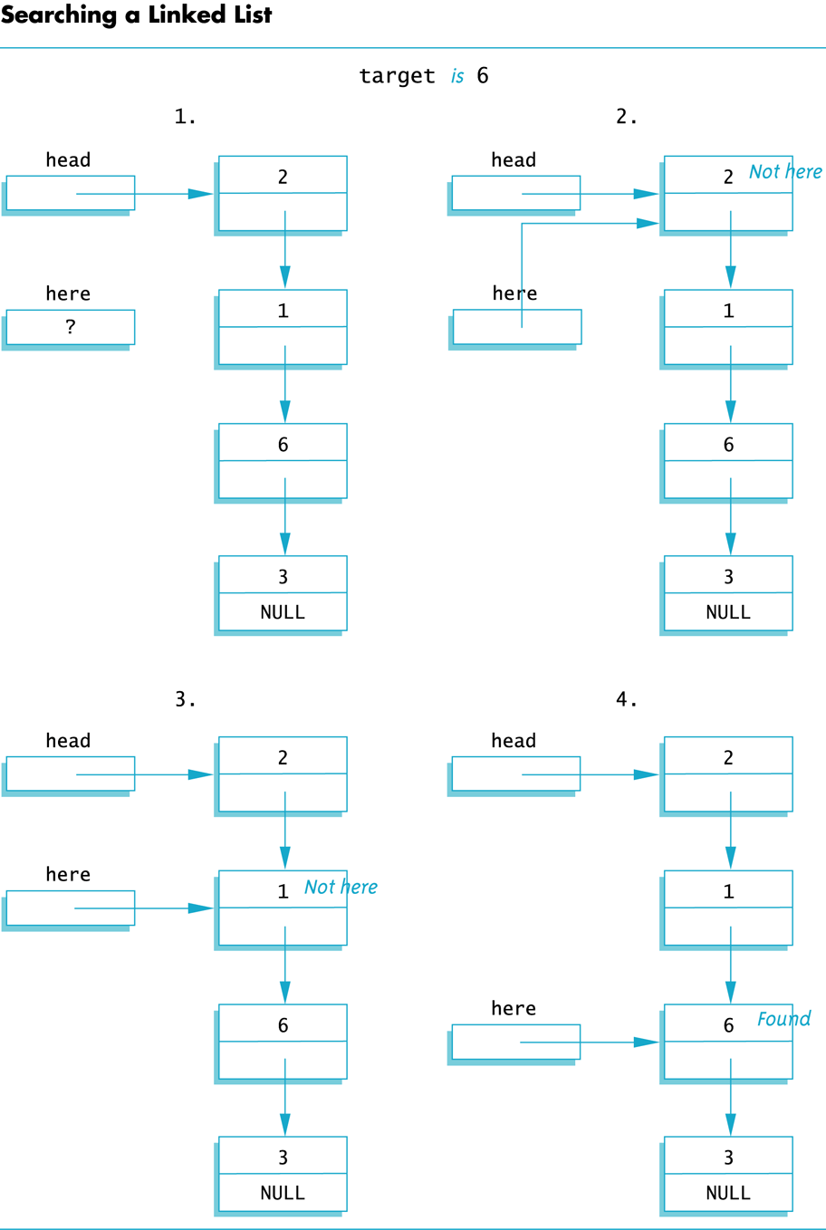
Display 15.6
Back
Next
Copyright © 2003 Pearson Education, Inc.
Slide <number>

Slide 43
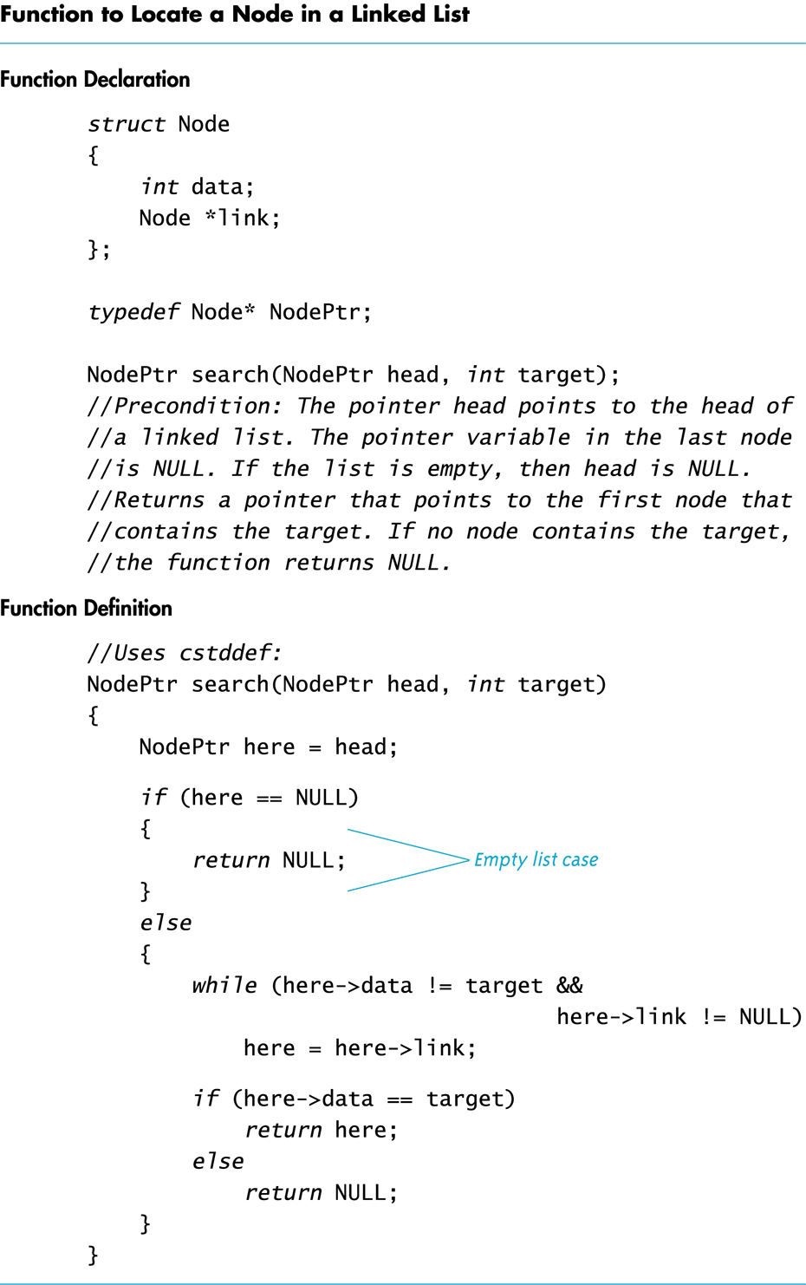
Display 15.7
Back
Next
Copyright © 2003 Pearson Education, Inc.
Slide <number>

Slide 44
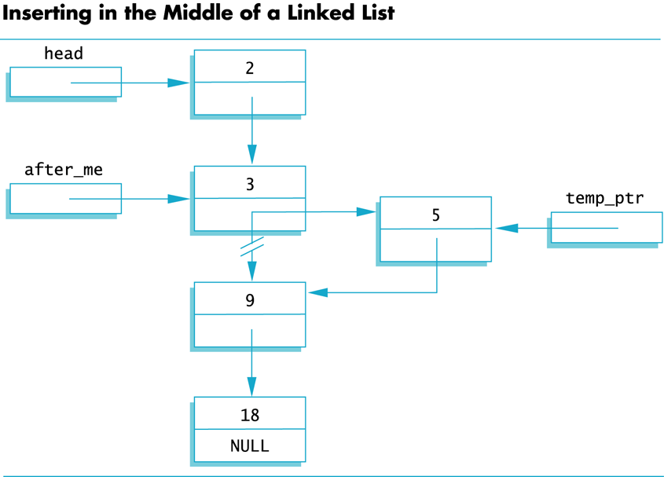
Display 15.8
Back
Next
Copyright © 2003 Pearson Education, Inc.
Slide <number>

Slide 45
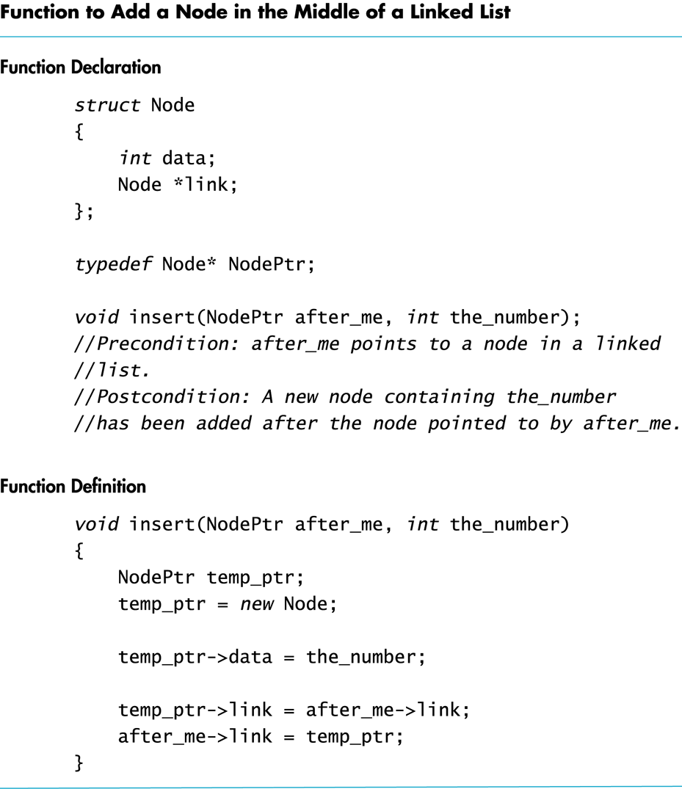
Display 15.9
Back
Next
Copyright © 2003 Pearson Education, Inc.
Slide <number>

Slide 46
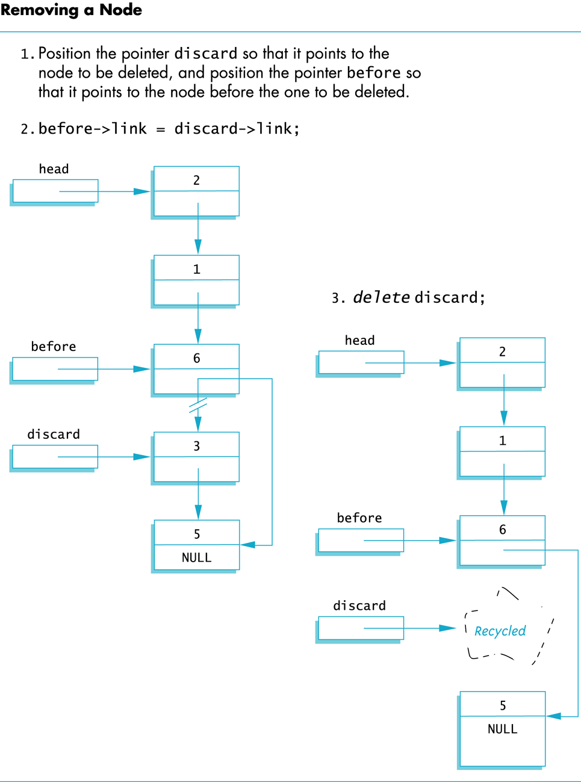
Display 15.10
Back
Next
Copyright © 2003 Pearson Education, Inc.
Slide <number>

